Slide 1
Lecture 12
Neighborhoods and Human Development: The international situation
12.3 Heterogeneity and Change in Developing Cities, Human Development
IUS 6.2.2
© Luís M. A. Bettencourt 2021

Slide 2
Heterogeneity and Change
in cities and neighborhoods

Slide 3
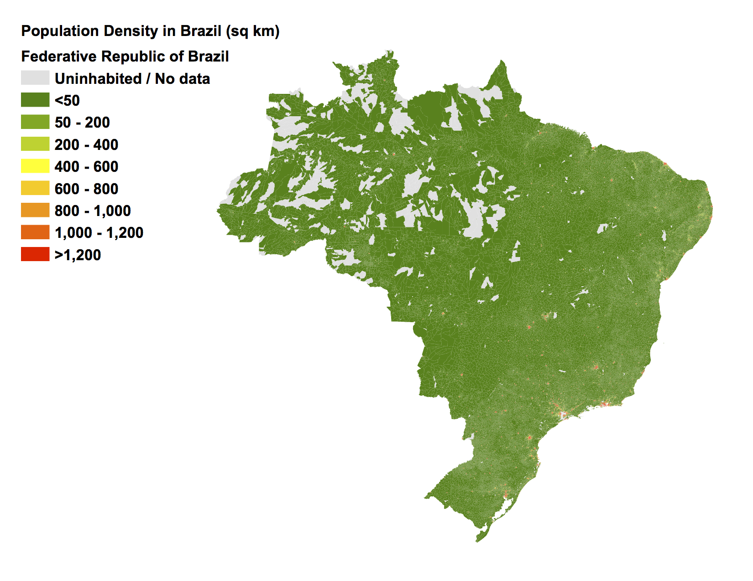
Population Density
(people/km²)
0 300 600 900 1200 km

Slide 4
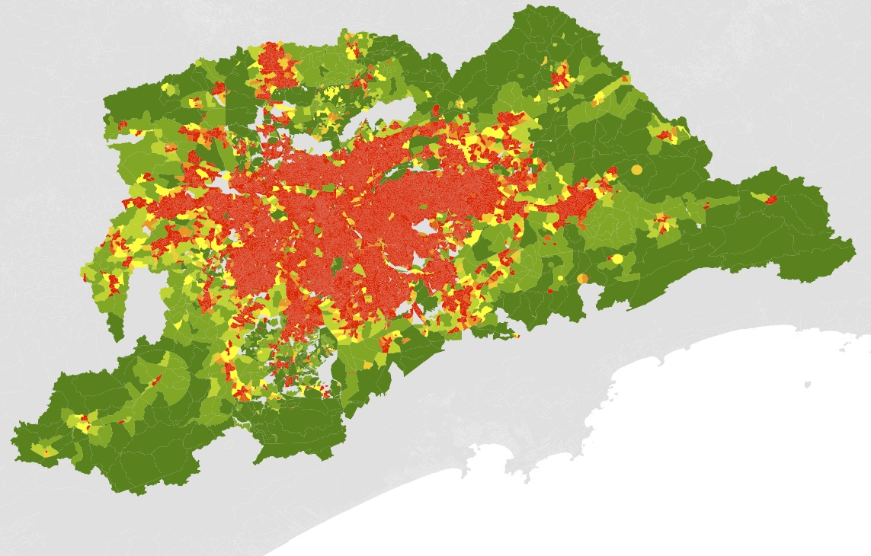
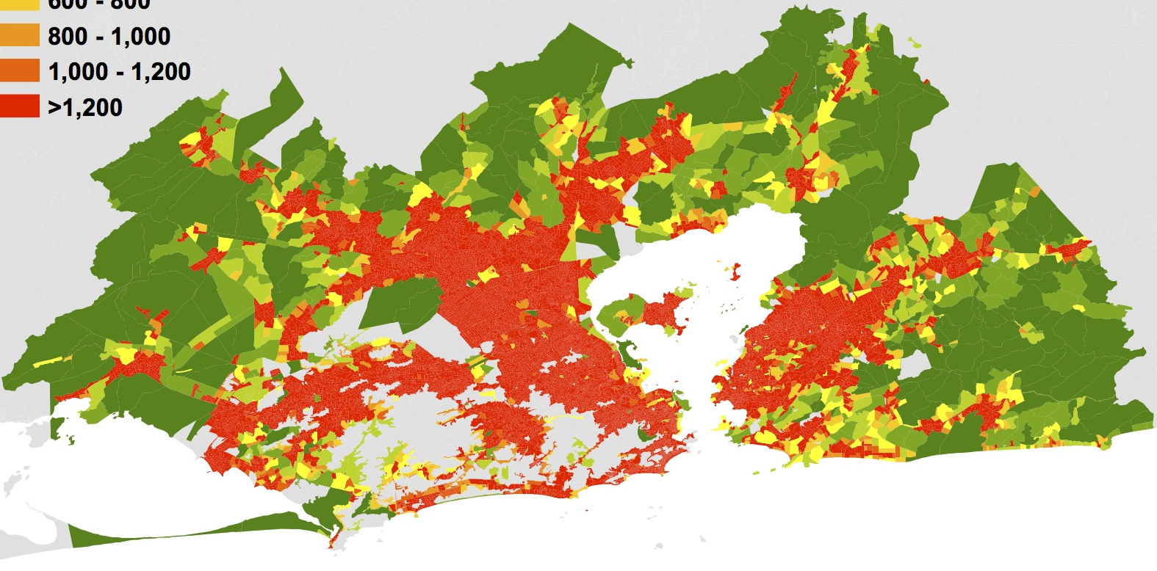
Sao Paulo
Population Density
(people/km²)
Rio de Janeiro

Slide 5
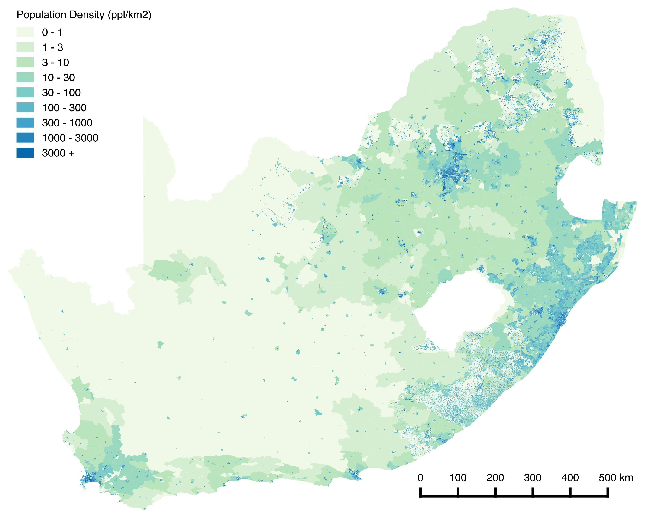

Slide 6
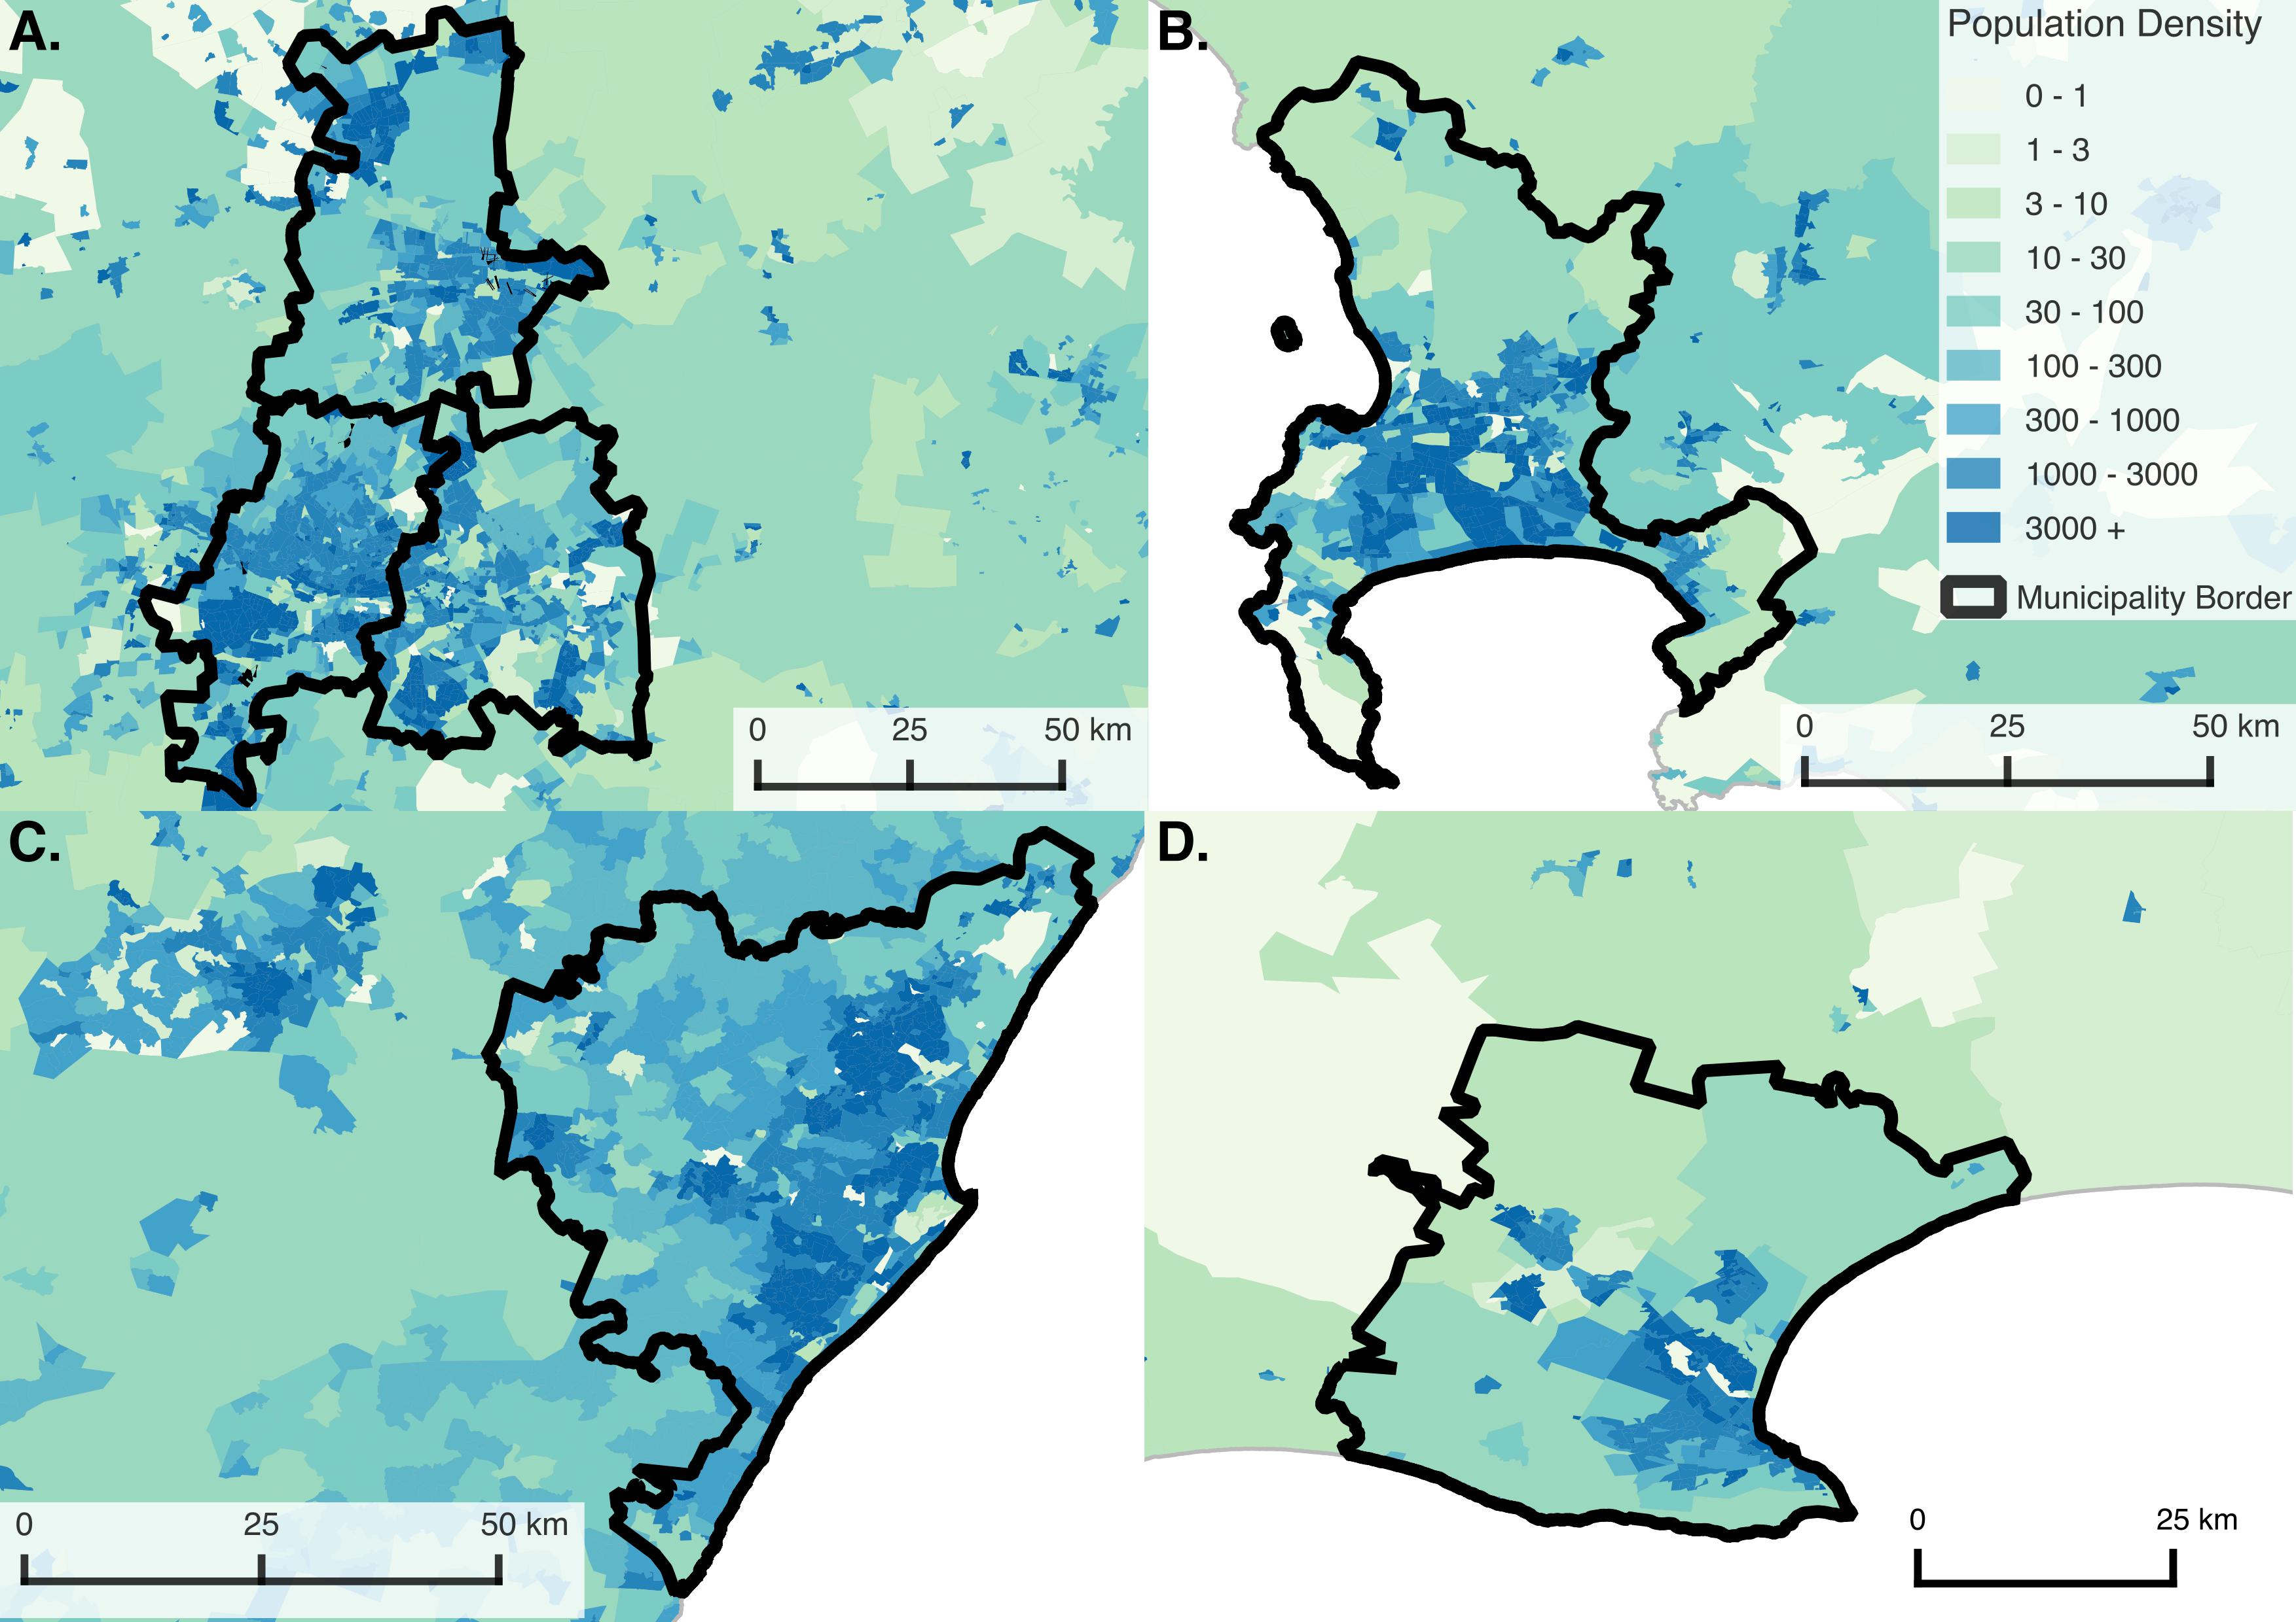
Notes:
A: Johannesburg, Ekurhuleni Metro (East Rand), City of Tshwane Metro (Pretoria):
B: Cape Town
C: Ethekwini Metro (Durban)
D: Nelson Mandela (Port Elizabeth)

Slide 7
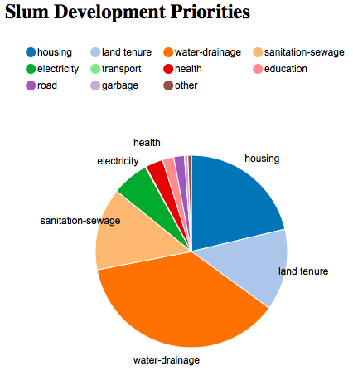
Self Identified Development Priorities

Slide 8
Self Identified Development Priorities

Slide 9
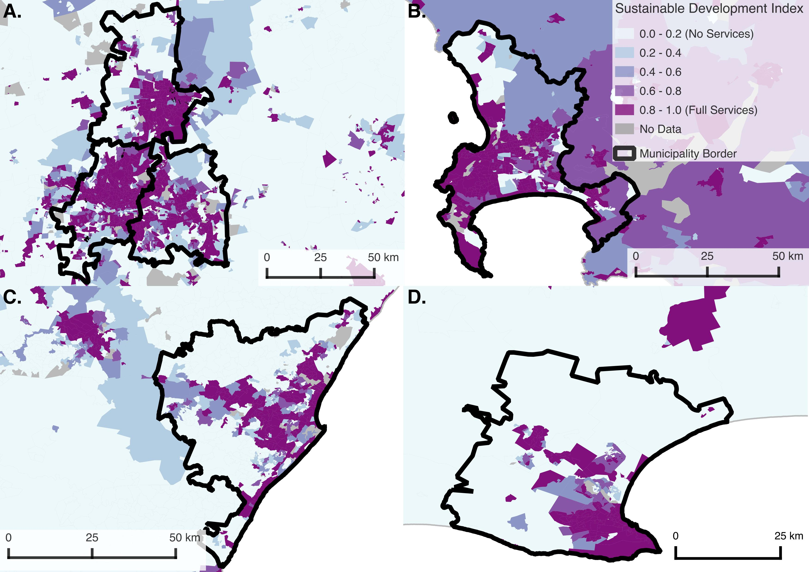

Slide 10
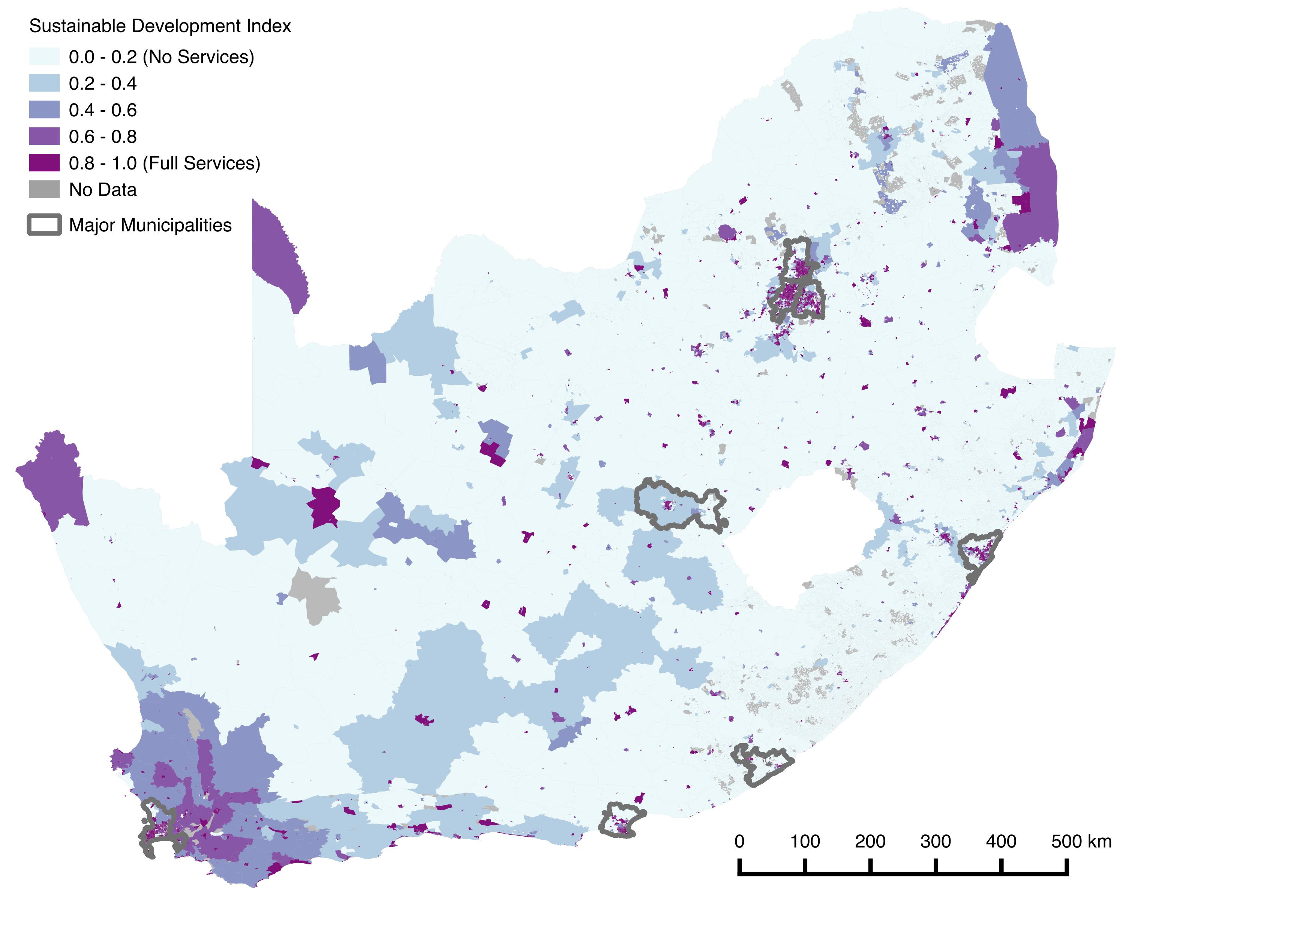

Slide 11
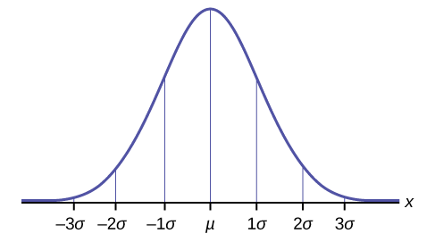
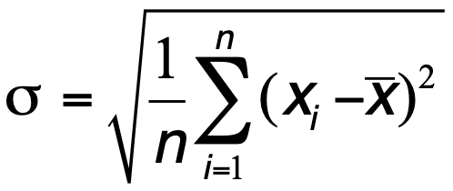
Measures of Heterogeneity
Standard deviation

Slide 12
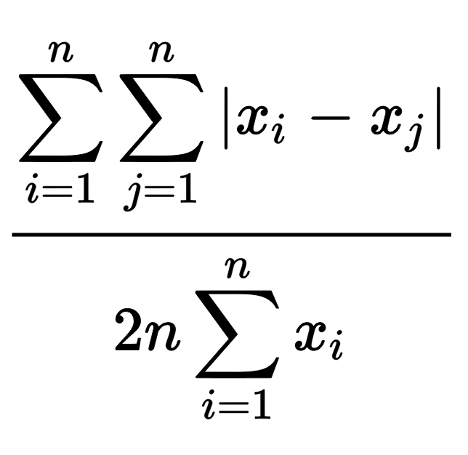
Measures of Heterogeneity
Standard deviation
Gini Coefficient
G =
Notes:
Measures of heterogeneity may be spatially explicit, or they may consider only the variation within a population, independently of any spatial structure.
The simplest measure of variation within a population is the standard deviation, and its relation to the mean of any socioeconomic variable.
The Gini coefficient is a well-known non-spatial measure of heterogeneity, often discussed in the context of income or wealth inequality.
Moran's I, by contrast, is one of the more widely used measures of spatial heterogeneity. It accounts for the level of similarity between the values of a given characteristic at two locations within a given distance from each other.
The Gini coefficient (or the standard deviation) and Moran's I are not necessarily correlated as this depends on the spatial structure of mixing between different populations. Any distribution of a resource within a population that shows some level of variation between individuals can be spatially distributed in a manner that is maximally clustered, meaning that Moran's I approaches I = 1, or perfectly anti-correlated (as in a checkerboard pattern) so that Moran's I approaches I = -1, or a random pattern, when Moran's I approaches I = 0.

Slide 13
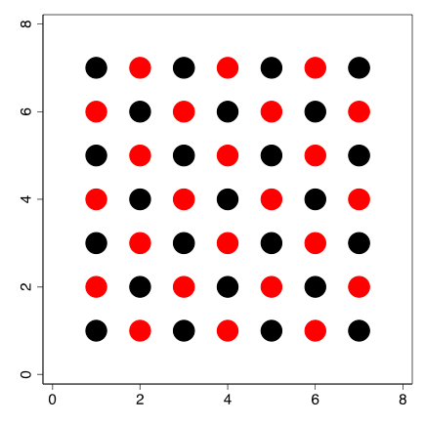
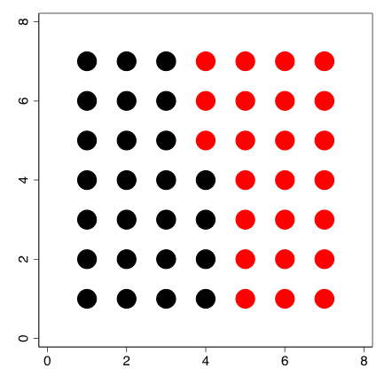
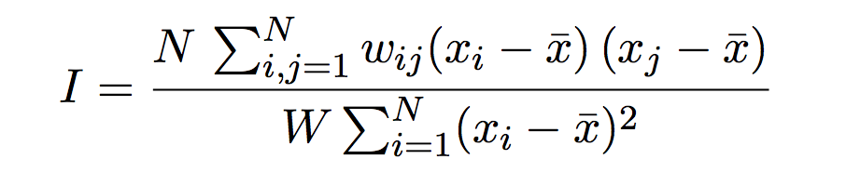
Measures of Heterogeneity
Standard deviation
Gini Coefficient
Moran’s I
G =
Notes:
Measures of heterogeneity may be spatially explicit, or they may consider only the variation within a population, independently of any spatial structure.
The simplest measure of variation within a population is the standard deviation, and its relation to the mean of any socioeconomic variable.
The Gini coefficient is a well-known non-spatial measure of heterogeneity, often discussed in the context of income or wealth inequality.
Moran's I, by contrast, is one of the more widely used measures of spatial heterogeneity. It accounts for the level of similarity between the values of a given characteristic at two locations within a given distance from each other.
The Gini coefficient (or the standard deviation) and Moran's I are not necessarily correlated as this depends on the spatial structure of mixing between different populations. Any distribution of a resource within a population that shows some level of variation between individuals can be spatially distributed in a manner that is maximally clustered, meaning that Moran's I approaches I = 1, or perfectly anti-correlated (as in a checkerboard pattern) so that Moran's I approaches I = -1, or a random pattern, when Moran's I approaches I = 0.

Slide 14
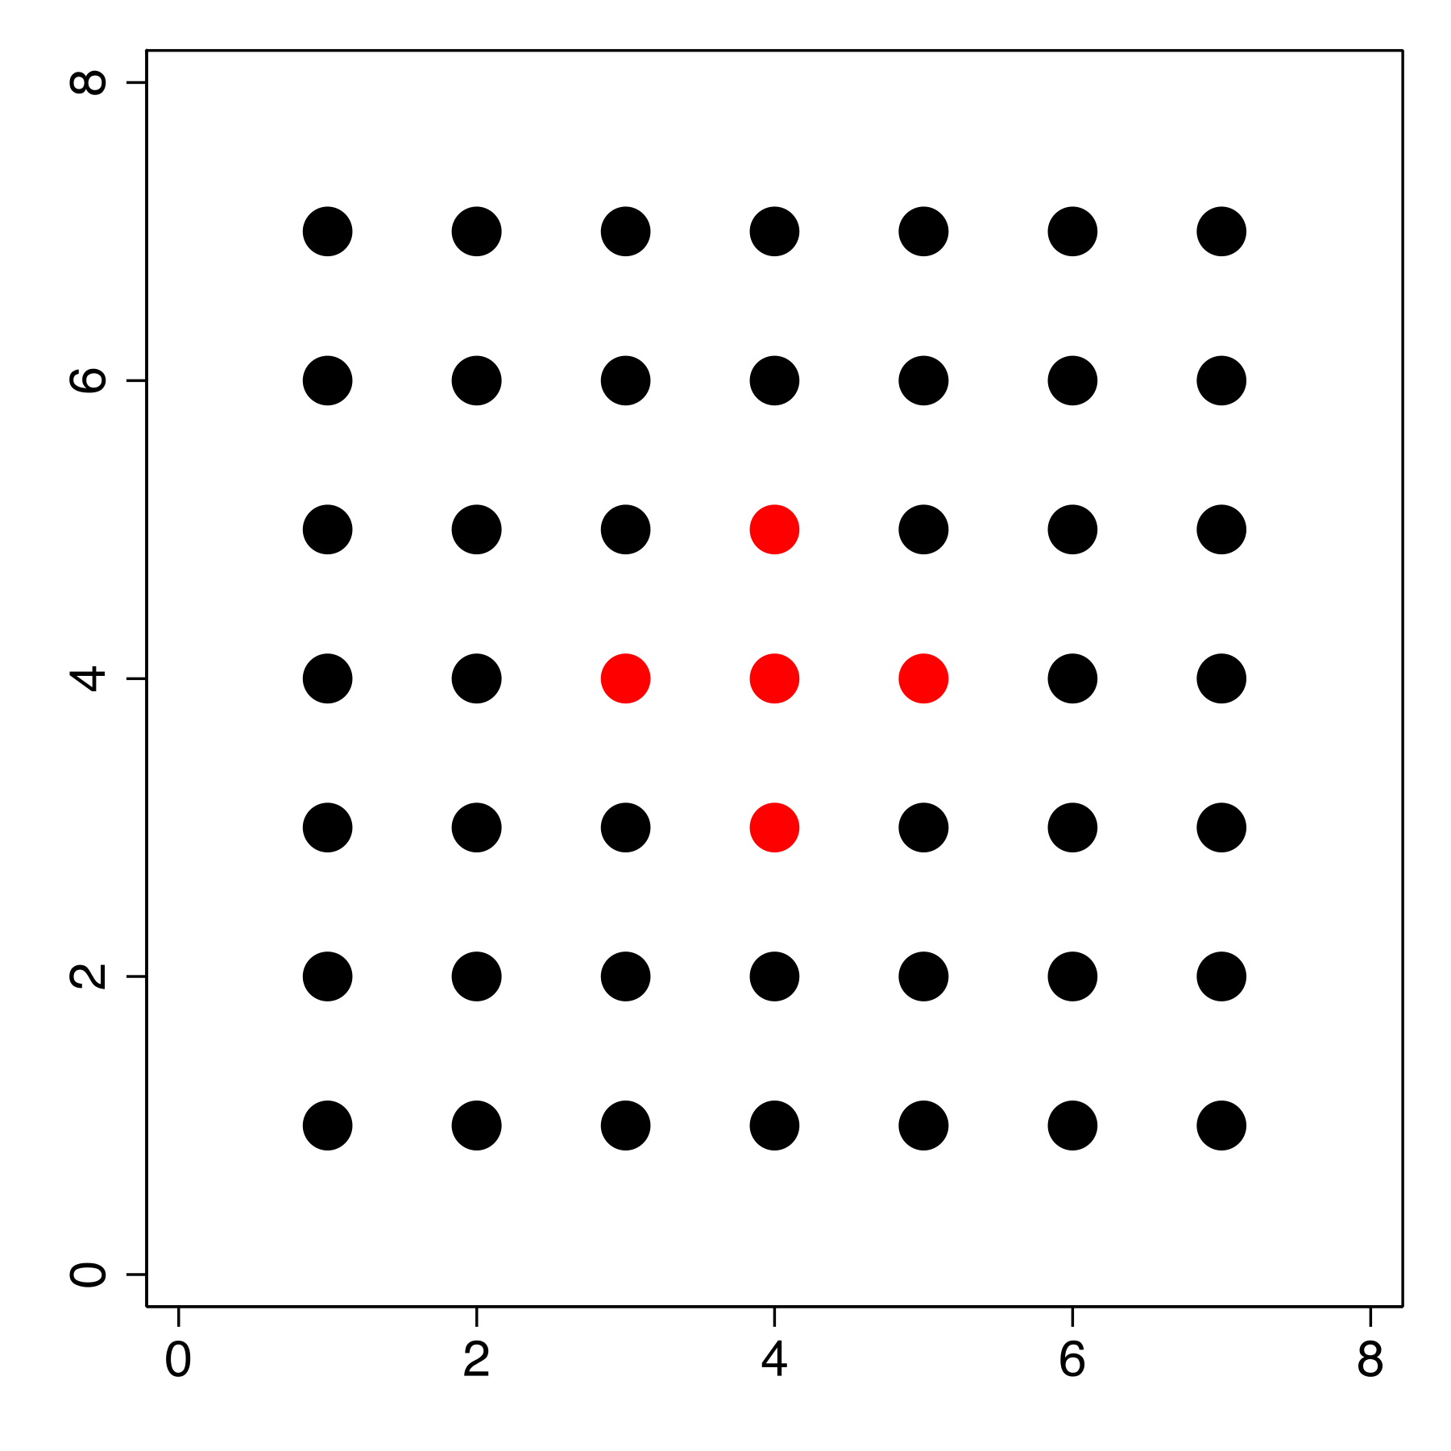
σ = 0.306; Gini = 0.083; Moran’s I = 0.045

Slide 15
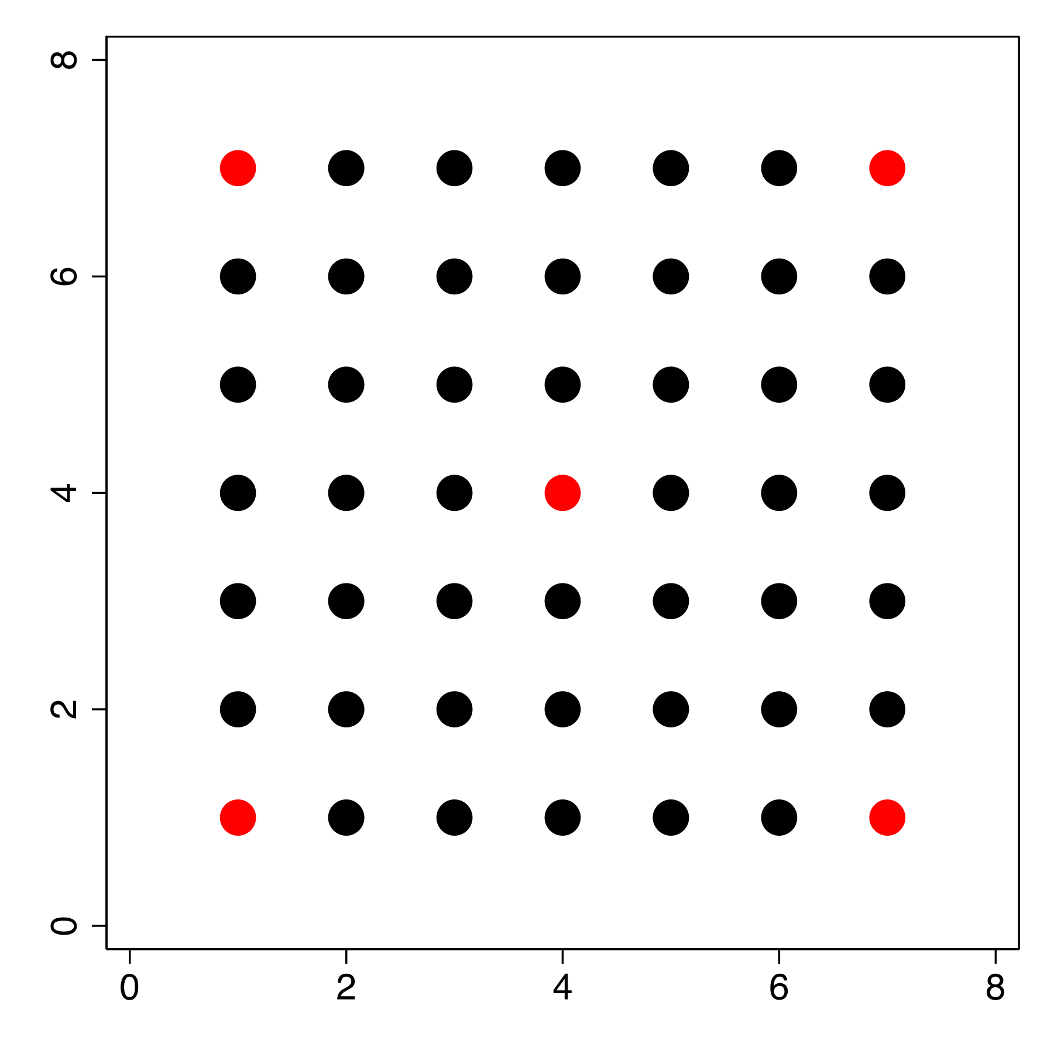
σ = 0.306; Gini = 0.083; Moran’s I = -0.030

Slide 16
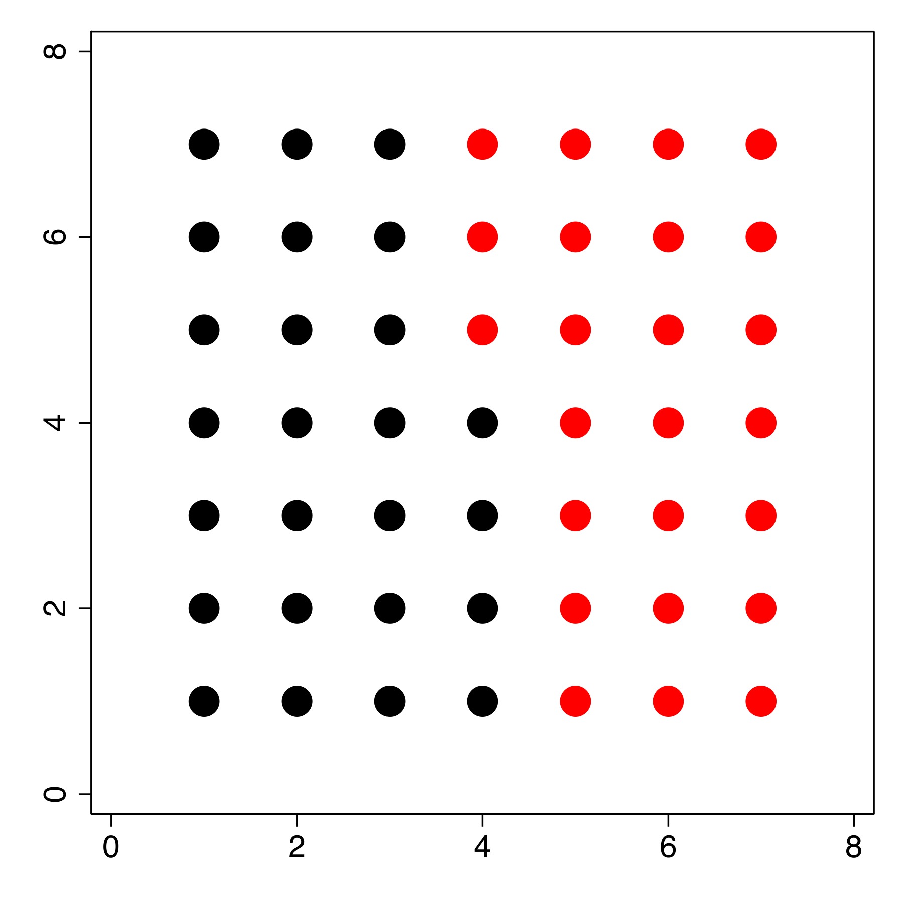
σ = 0.505; Gini = 0.168; Moran’s I = 0.247

Slide 17
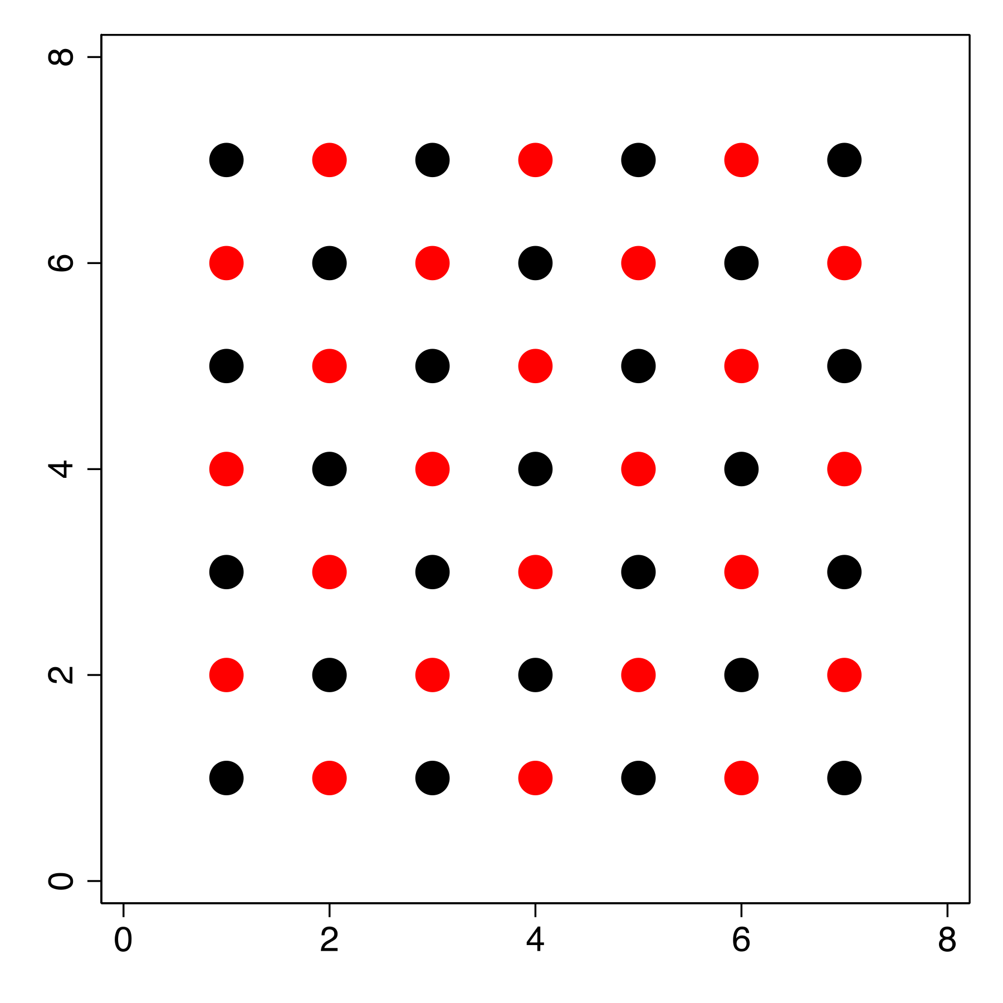
σ = 0.505; Gini = 0.168; Moran’s I = -0.090
Notes:
Only Moran’s I is sensitive to the spatial configuration of different colors, while the other quantities express how much mixing there is overall. Note that σ and Moran’s I are unchanged by linear transformations of the quantities of red and black dots, but the Gini coefficient is not. For example, using the same spatial layout as panel D; with black = 100 and red = 101 yields σ = 0.505; Moran’s I = -0.090 and Gini =0.002.

Slide 18
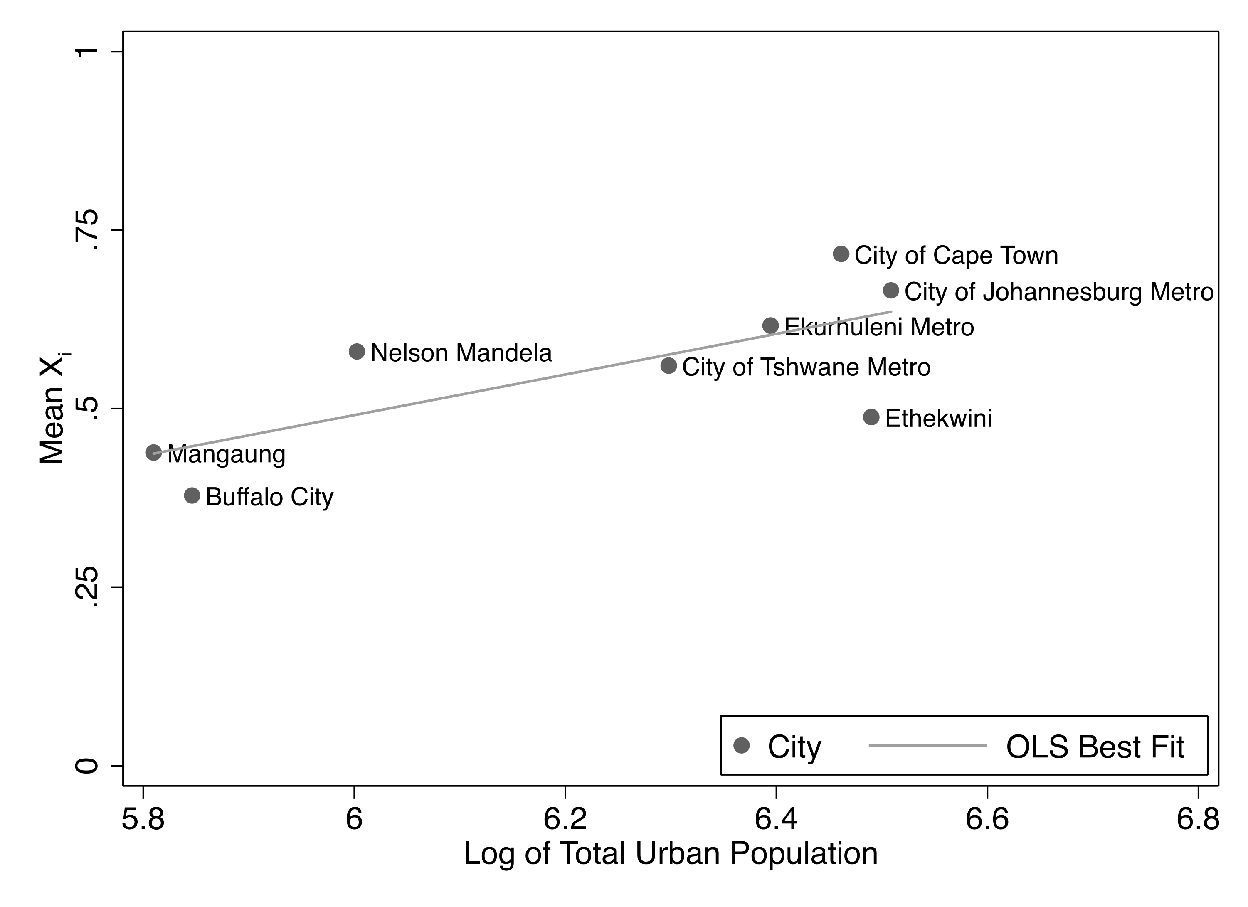
Notes:
here we show the mean X for urban areas of different sizes in Brazil and South Africa. In general, we find that the level of service access increases with city size a trend that is especially clear in South Africa. This relative advantage of cities in terms of access to services and thus, at least some of the dimensions of sustainable development, is consistent with urban agglomeration effects and points to a range of reasons why urbanization rates continue to grow in developing cities beyond strictly economic motifs. living in larger cities means that, on average, citizens obtain greater access to measures of sustainable development sooner. However, these averages hide large heterogeneities in access, an issue to which we now turn.

Slide 19
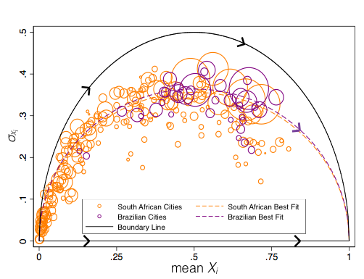

Slide 20
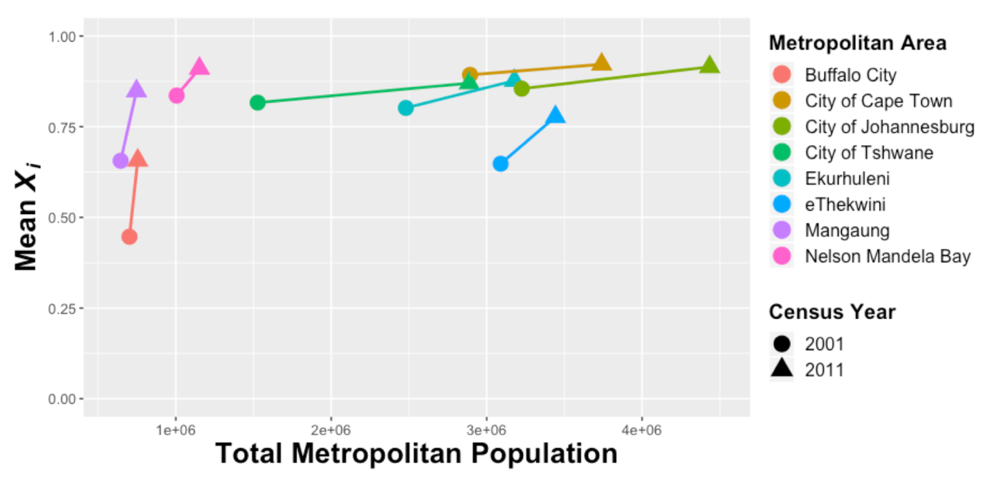
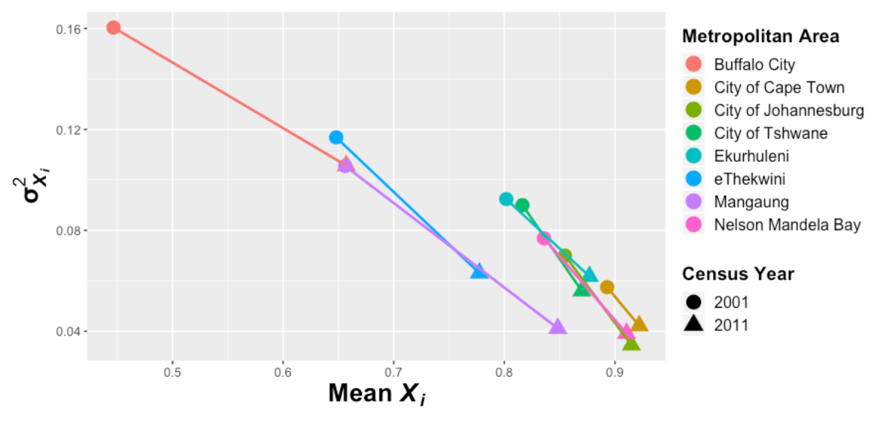
Temporal Changes in X_{i}
Figures by Mollie Gaines (ORNL SULI student)

Slide 21



Basis: Human-Environment Interactions
Physical, Social, Economic, Cultural
Neighborhood Effects
Capabilities Approach
Central Concept: Human Ecology
Central Concept: Well being means that people have the capacity
to reason and act in their own contexts
Home Turf: Sociology
Home Turf: International Development Economics and Ethics
Metrics: Behavioral outcomes, poverty, race, inequality
Metrics: Human Development index
Bill Wilson
Amartya Sen
Martha Nussbaum

Slide 22
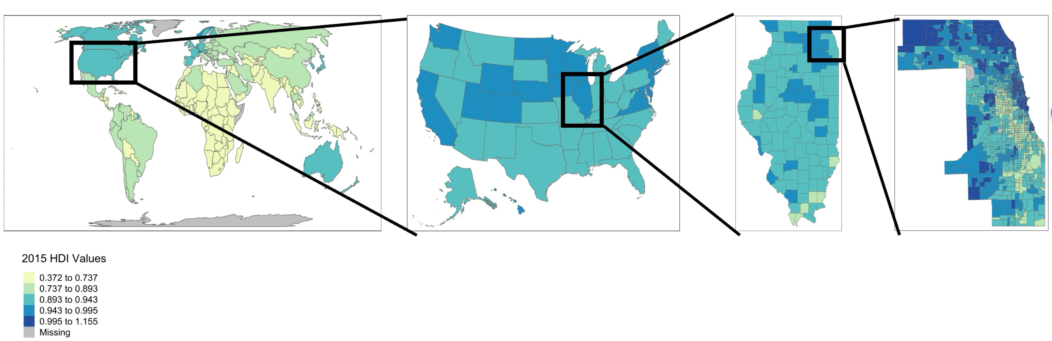
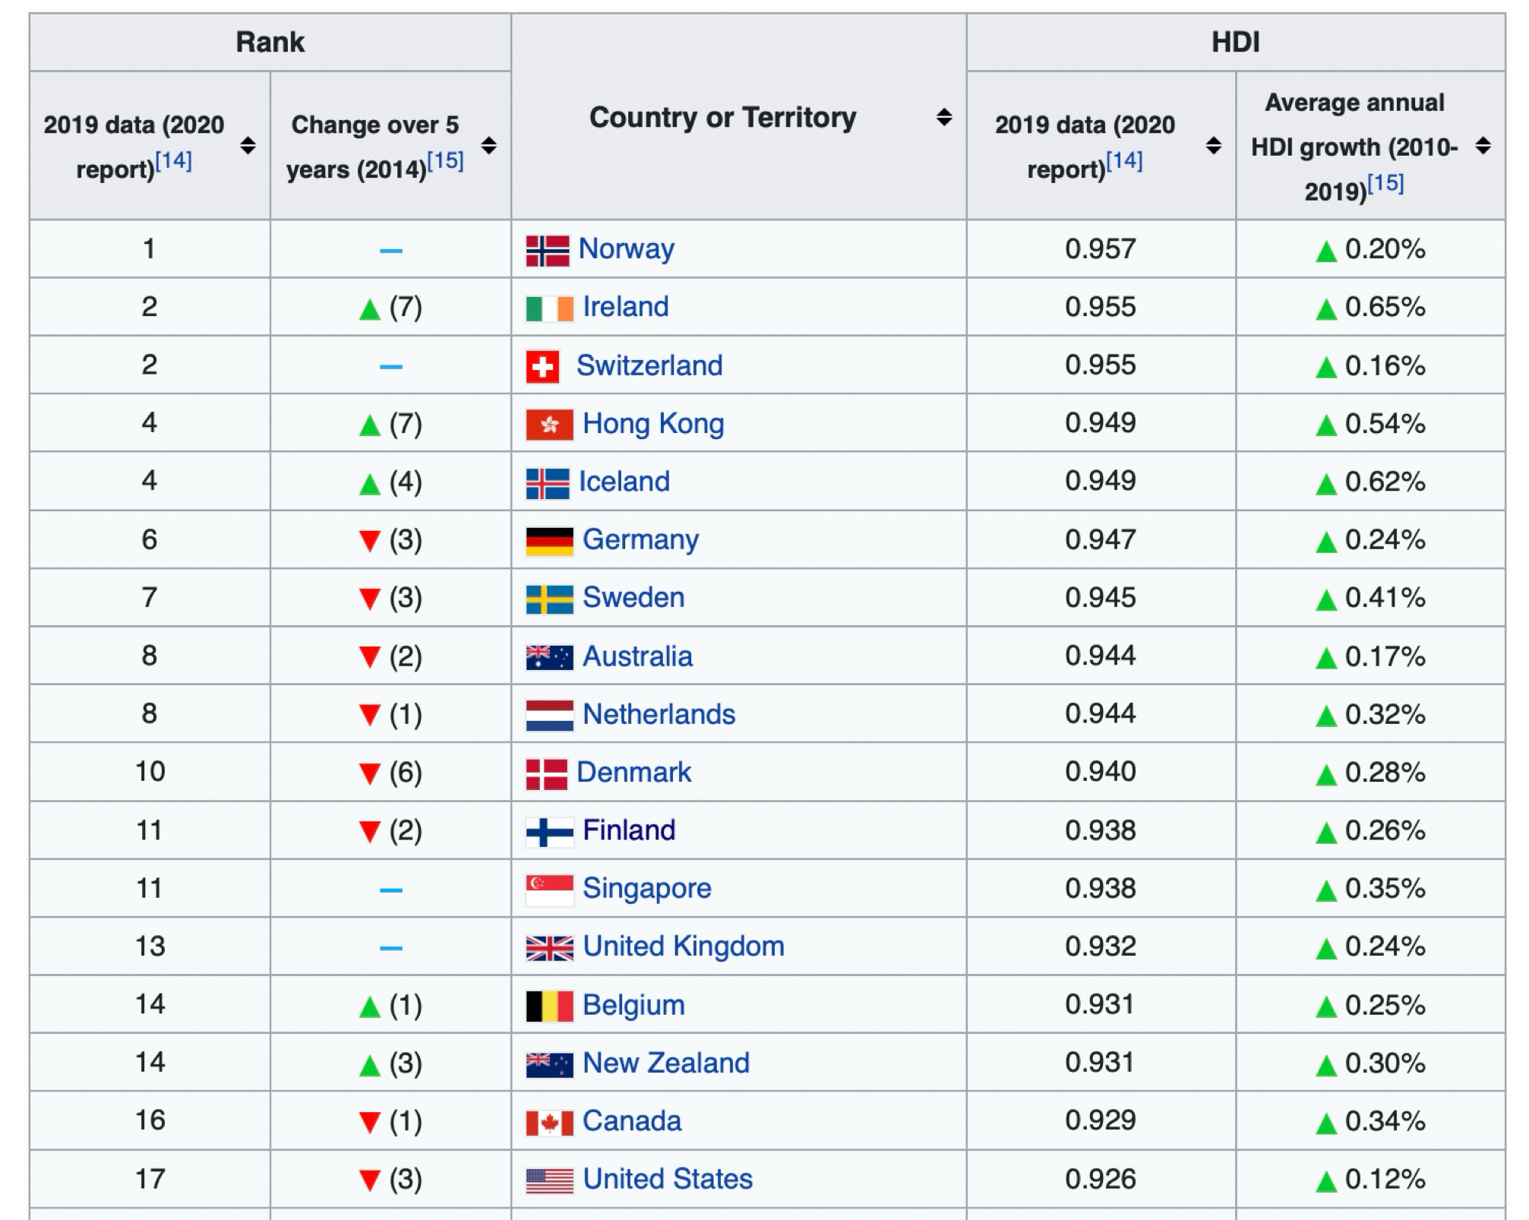
Human Development Index
“measures the ability of human populations to lead, long , healthy and fulfilled lives”
credit: Neil Sheth (UChicago)
$${HDI}_{i}={\left({education}_{i}.{lifeexpectancy}_{i}.{realincome}_{i}\right)}^{1/3}$$
The US is now # 17

Slide 23
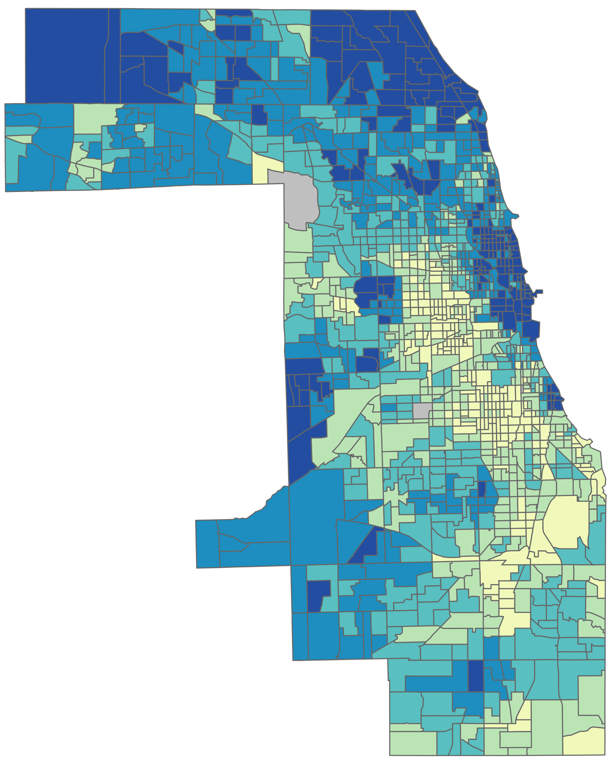
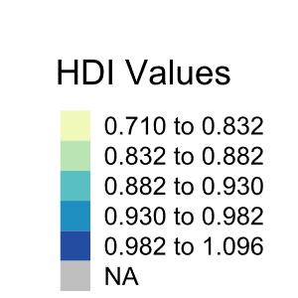
Measuring the Human Development of Chicago neighborhoods
better than Norway
worse than China or Mexico
credit: Neil Sheth (UChicago)

Slide 24
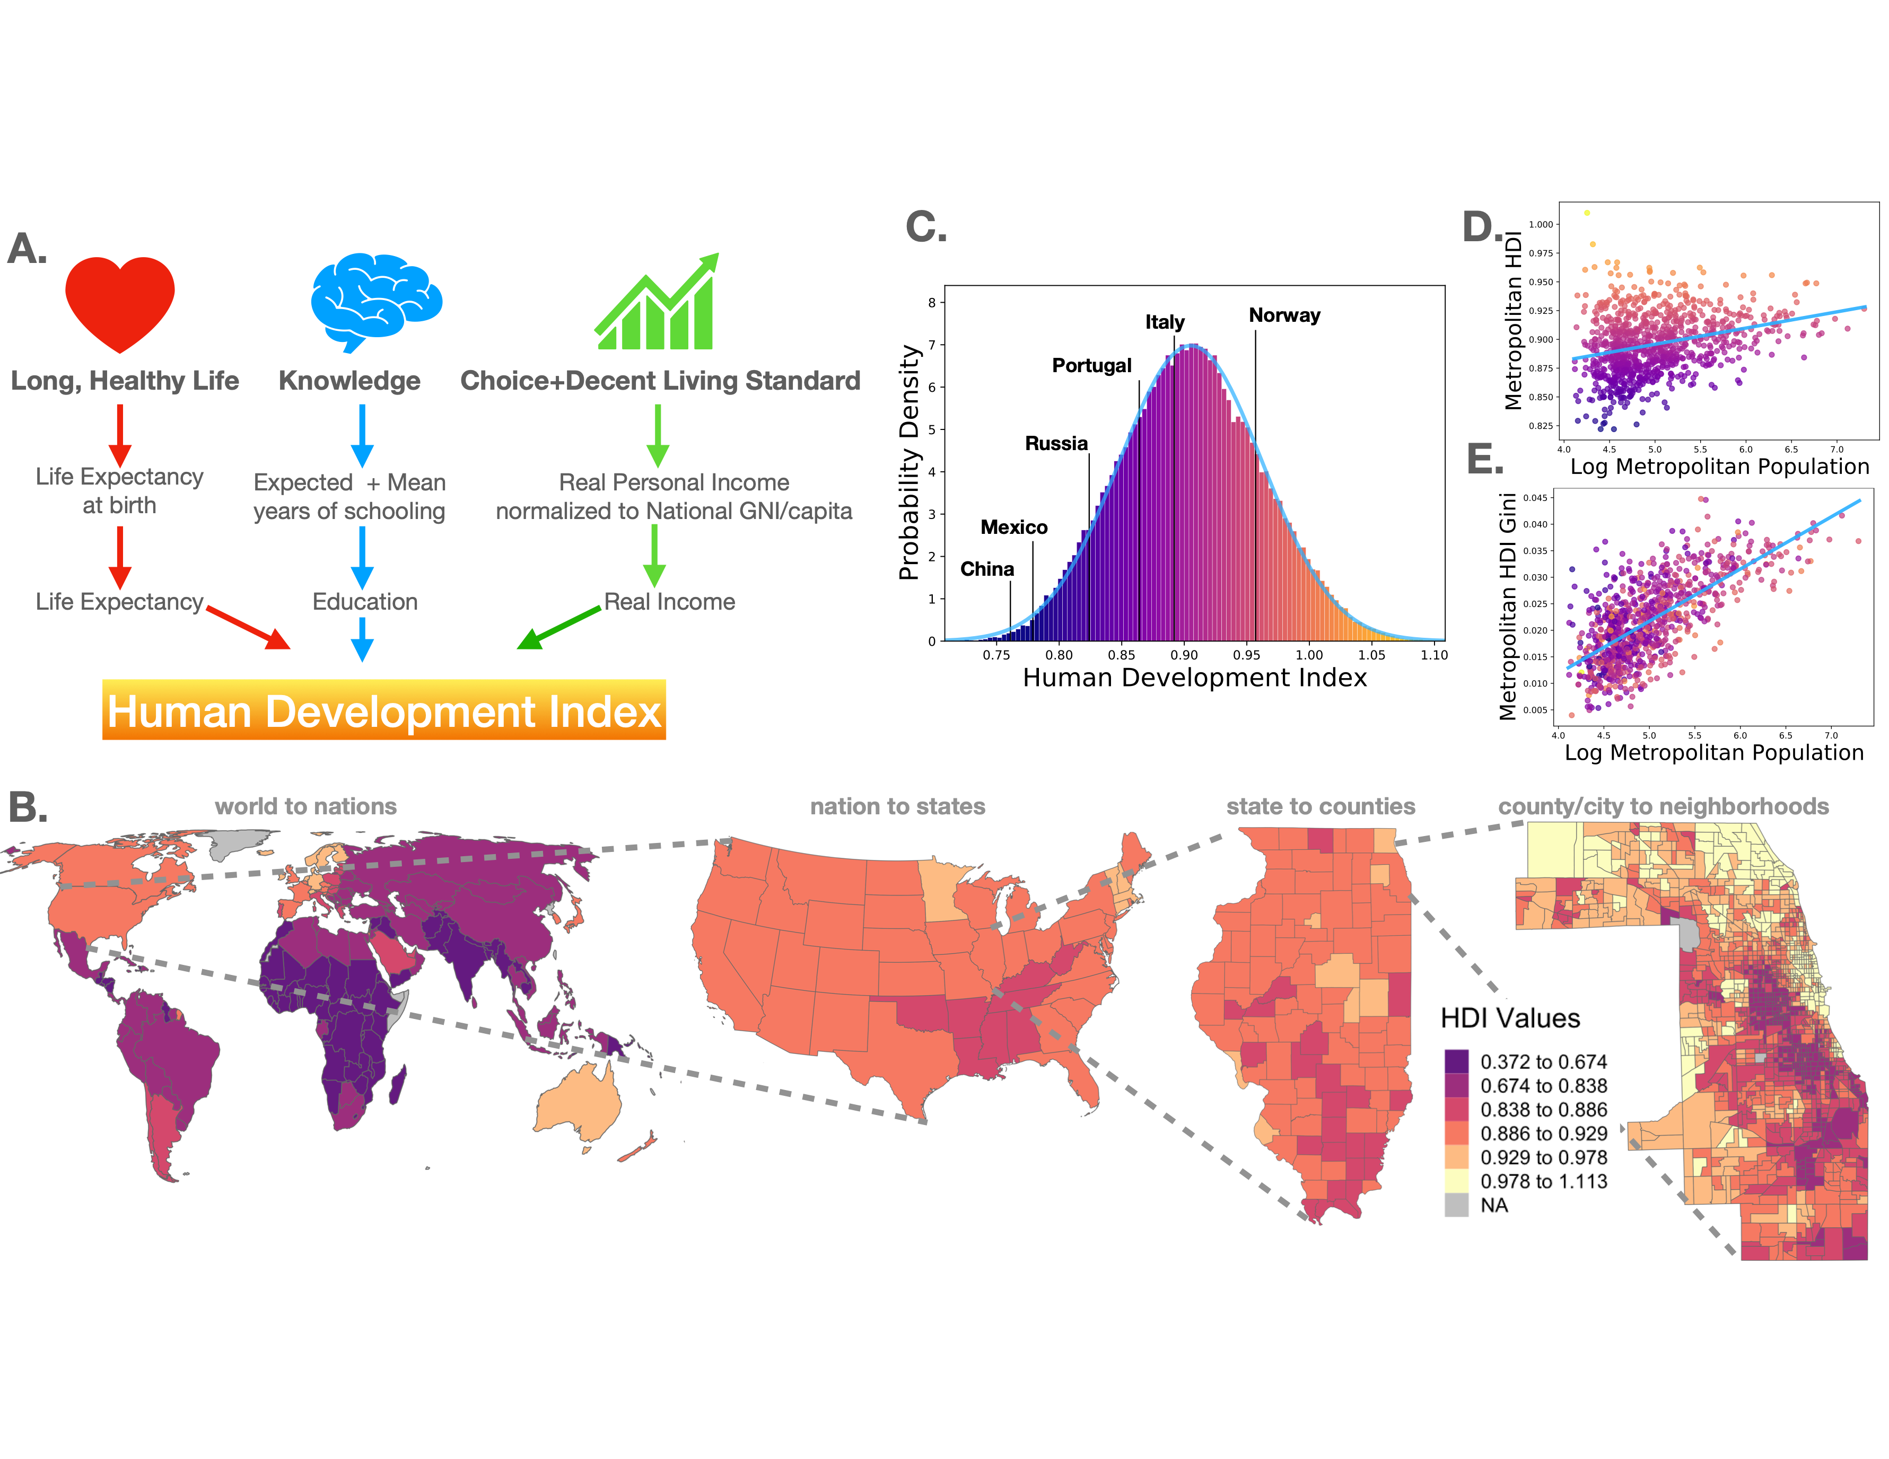
HDI increases with city size
inequality increases with city size faster
Check out the interactive map at:
https://communityhdi.org/

Slide 25
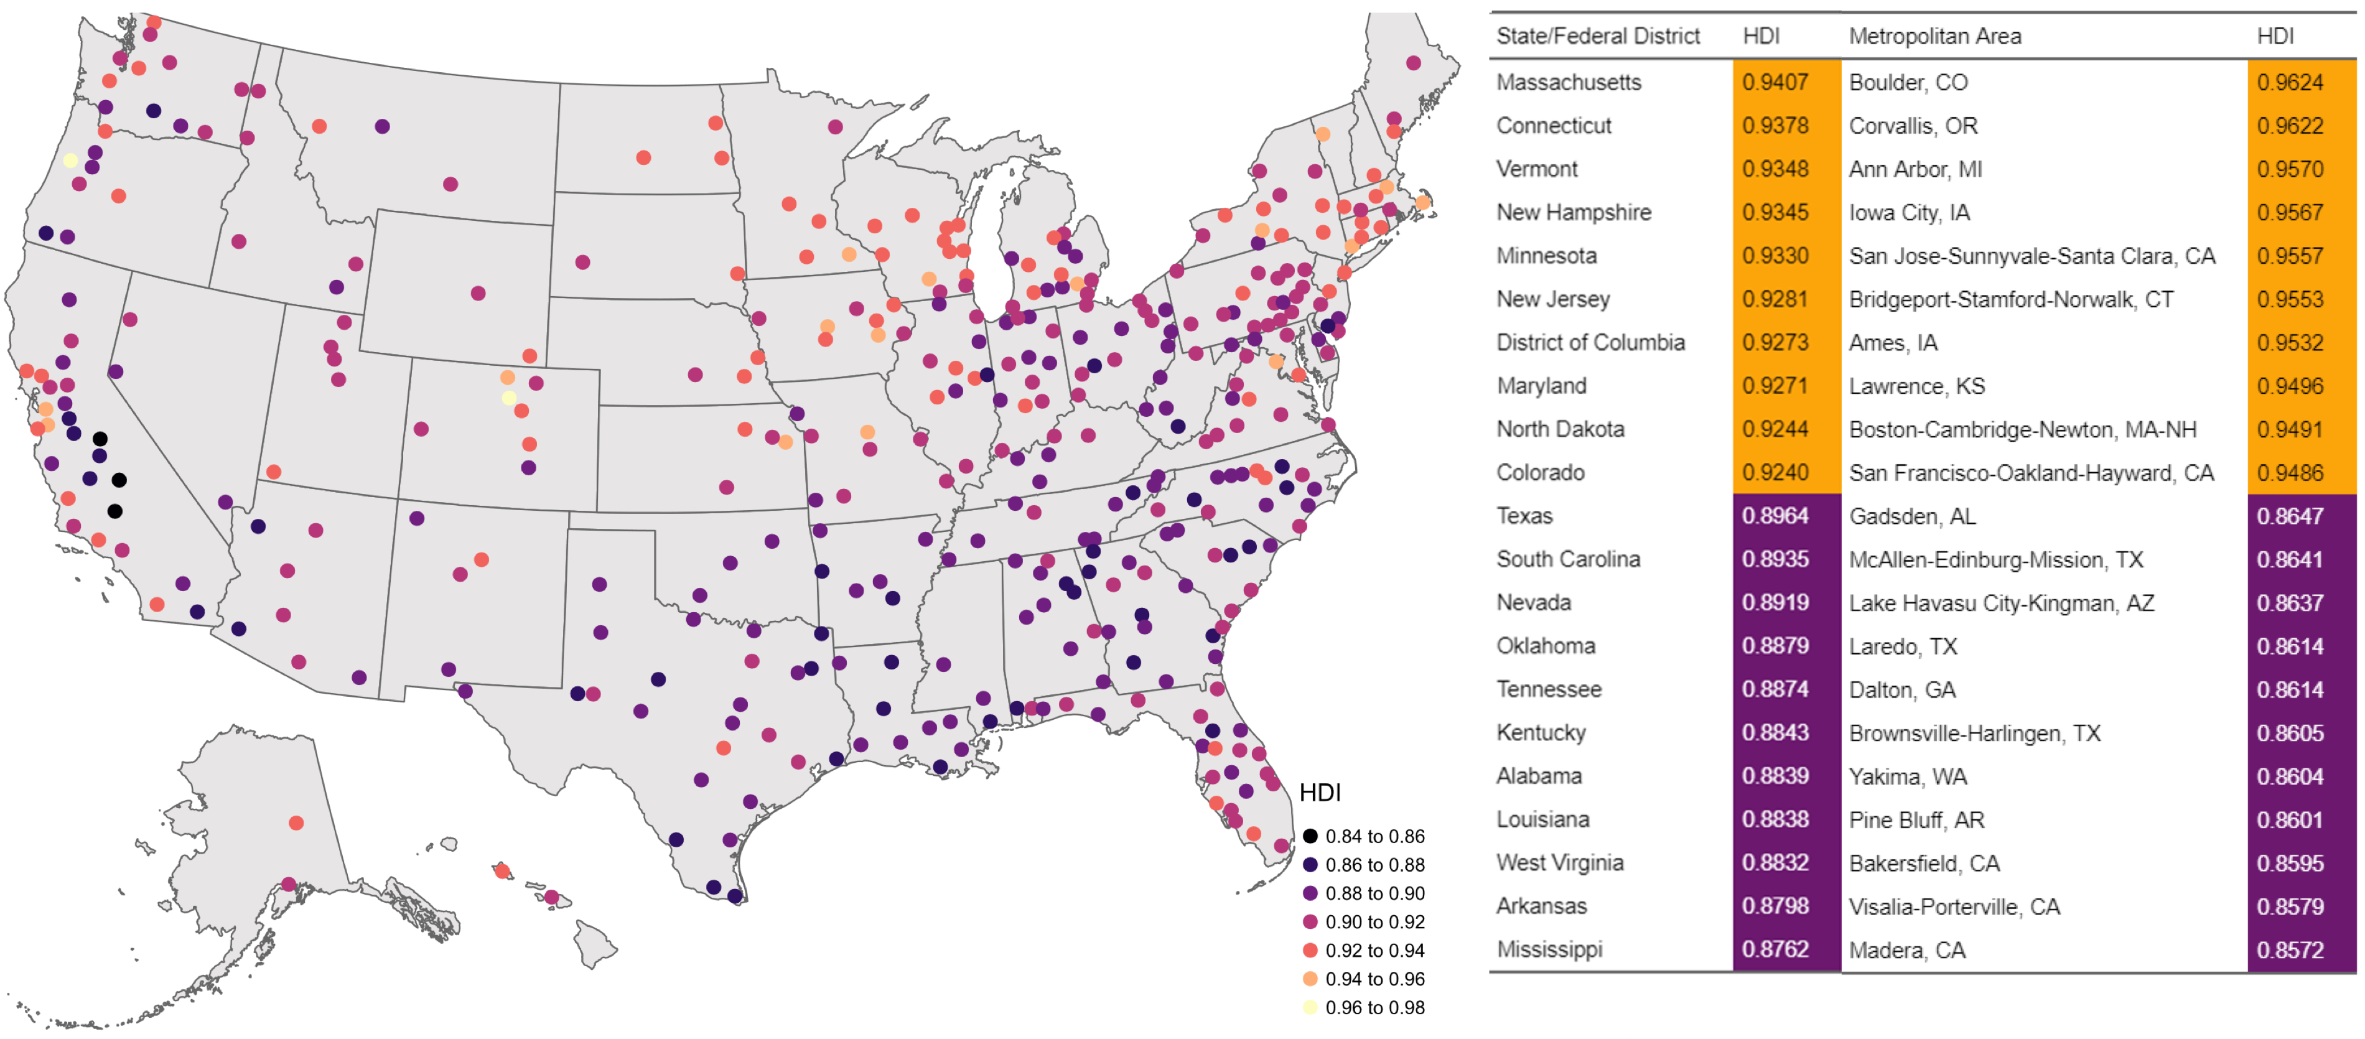

Slide 26
